Slide 1
MULTI PARTY CONFERENCE CHAT
GROUP 04 MEMBERS:
SHREYA KAMATH
RAJESH KANNAN M
NIKHITHA RAVI
SNEHA MARIAM CHACKO

Slide 2
CONTENT
Introduction
Requirement
Use Case Diagram
Functional Overview
Conclusion

Slide 3

INTRODUCTION
Multi Party Conference Chat provides an effective communication channel allowing multiple users to communicate with each other.
The server make sure to connect with multiple clients and allows message broadcasting.
Authentication is required to verify the credentials when the user logins to access the server session.

Slide 4
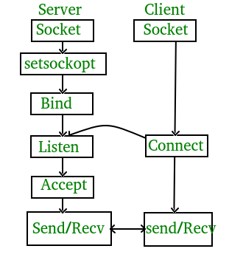
CLIENT-SERVER CONNECTION
Client - Server connection is established using TCP/IP Protocol.
TCP/IP protocol is a connection-oriented protocol.
It makes sure that the server and client establish a connection with each other.

Slide 5
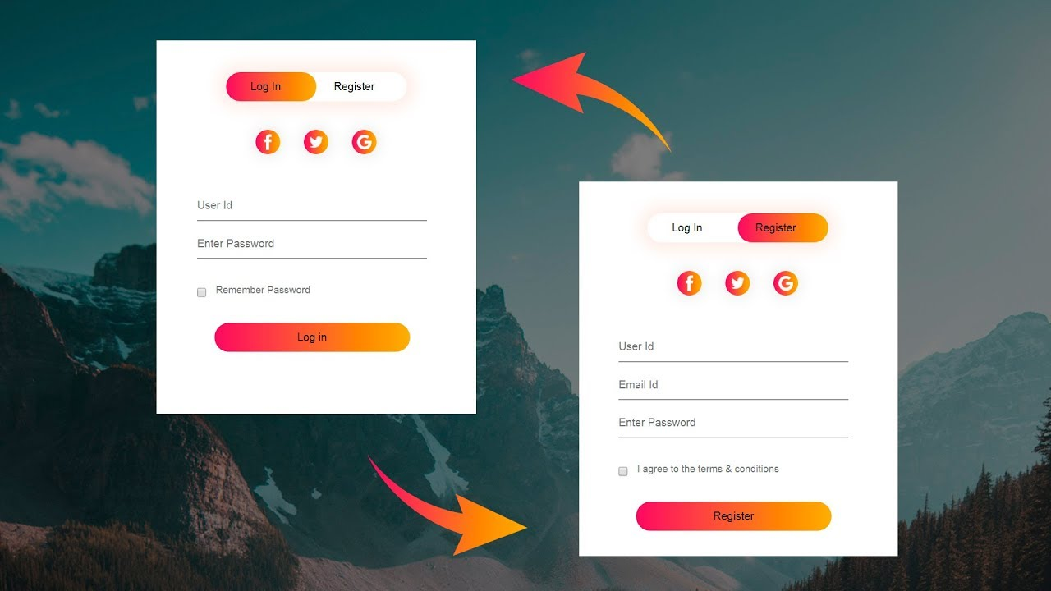
LOGIN AND REGISTRATION
A new user should register first, after successful registration the credentials are stored in a file.
The registered user can now login with userID and password which they created.

Slide 6
CONCURRENT SERVER
Concurrent Server can handle multiple clients at the same time.
Every client will send the chat request and this has to be maintained by the concurrent server

Slide 7
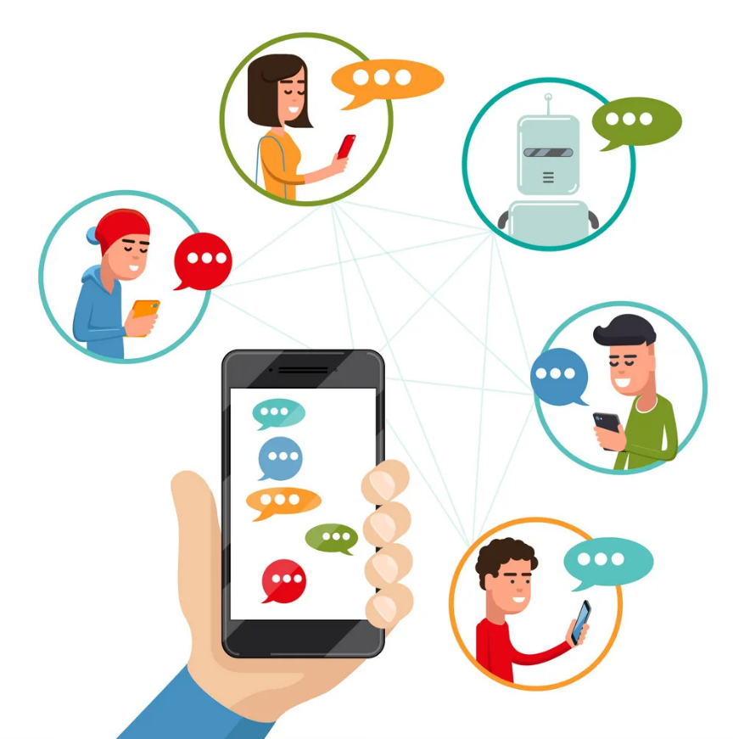
MESSAGE BROADCASTING
Each client will have their own unique user ID.
Whenever the client is sending a message, it will be broadcasted to all other active clients who are connected to the server.

Slide 8
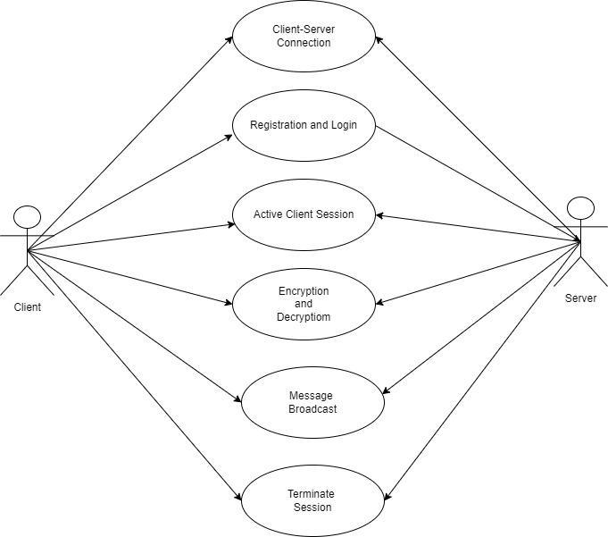
USE CASE DIAGRAM

Slide 9
FUNCTIONAL OVERVIEW
MPCC works in a client-server model which uses TCP/IP protocol.
The MPCC allows the user to get registered and upon successful registration communication with other users is enabled.
It also enables broadcasting of messages sent by one user to all the other users active in the conference chat.
The server performs client authentication and broadcasts the message from one user to all the other users in the chat.

Slide 10
CONCLUSION
The Multi party conference chat is mainly based on the concept of achieving an effective communication channel allowing multiple users to communicate with each other easily.
The MPCC allows the user to get registered and upon successful registration communicate with other users.
It also enables broadcasting of messages sent by one user to all the other users active in the conference chat.

Slide 11


